Slide 1
CS 6364 - AI PROJECT PRESENTATION
Image Classification - Comparing CNN models on CIFAR-10 for fast response applications
Rathang Rajpal (rxr210009)
Yash Vijaynarayan Gupta (yxg210002)
Team 21

Slide 2
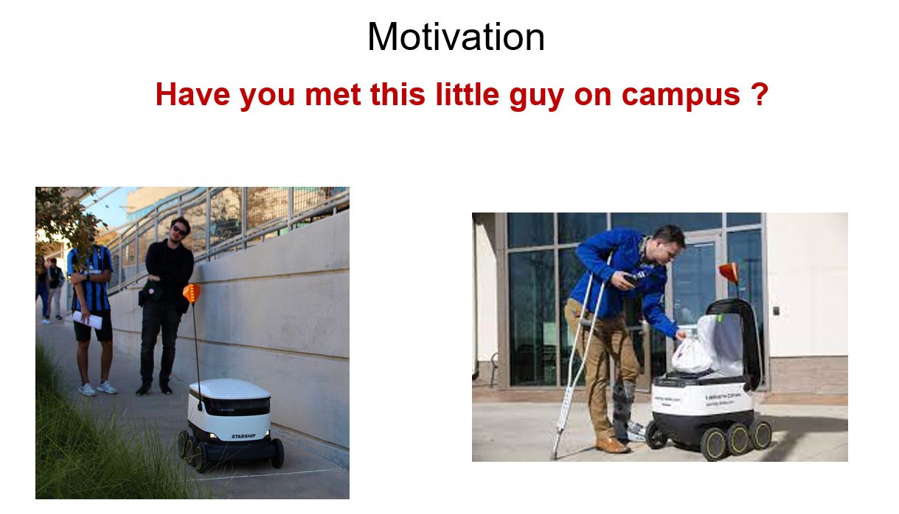

Slide 3
INTRODUCTION
Motivation -
Most of the time image classification problem is like a subset of computer vision problem
Applications like automobiles or automatically driven vehicles make use of light models to get results suitable for quick response environment.
Problem Statement –
Classification of images into different classes and assign labels to the images and predict the classes
Look into variety of model architectures and compare their results
Conclude with results based on the variety of model instances by varying the hyperparameters and understanding the results for fast response systems
Play with internal architecture blocks to observe changes that can improve results
Significance of problem -
Low inference time for quick response
Light on hardware requirements for image classification

Slide 4
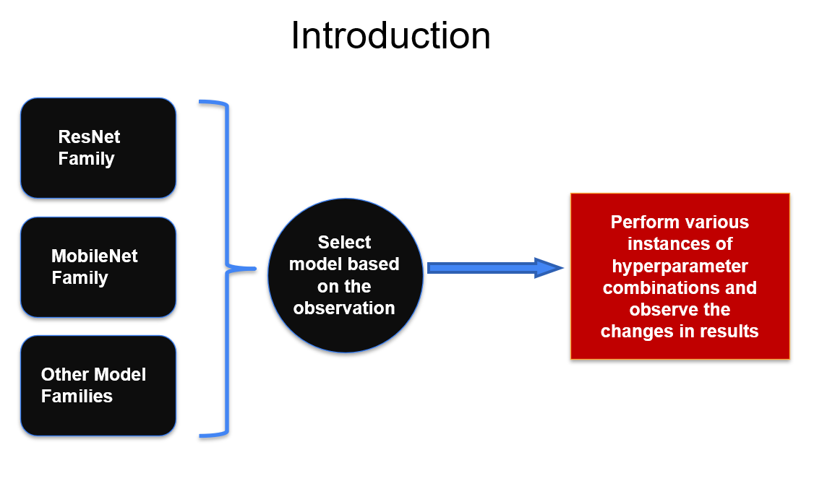

Slide 5
DATASETS USED
Datasets -
1. CIFAR 10 -
CIFAR-10 (Canadian Institute of Advanced Research)
Huge dataset containing images of animals, herbivores, people, aquatic mammals etc
Total of 60,000 images with each image of size 32x32
Total of 10 classes
2. CIFAR 100 -
CIFAR-100 (Canadian Institute of Advanced Research)
Huge dataset containing images of animals, herbivores, people, aquatic mammals etc
Total of 60,000 images with each image of size 32x32
Total of 100 classes grouped into 20 superclasses

Slide 6
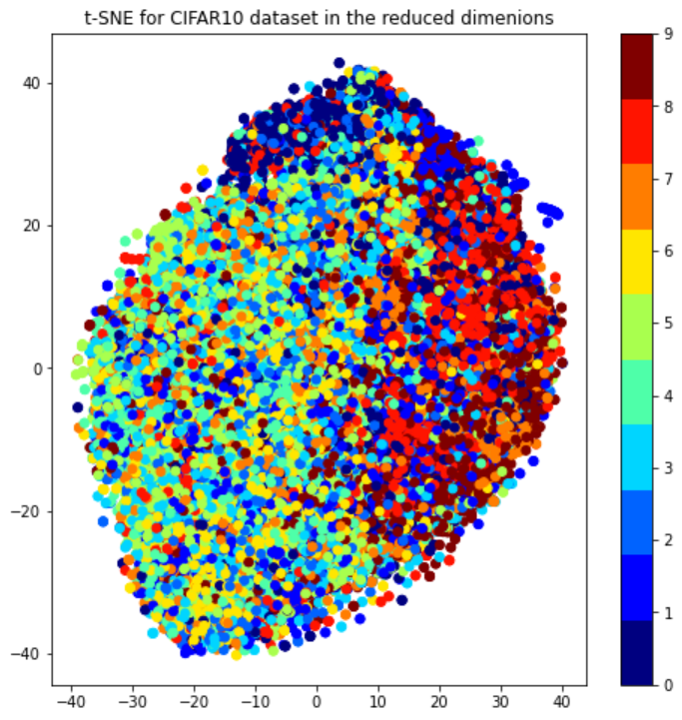
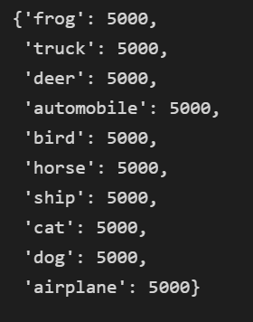
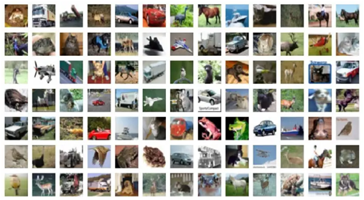
Exploratory Data Analysis
Types of classes
Images

Slide 7
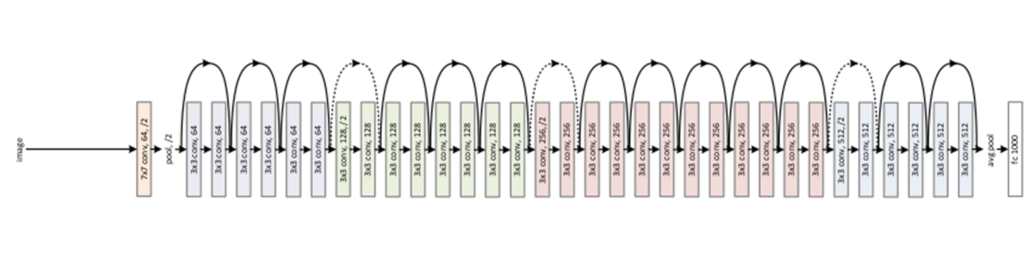
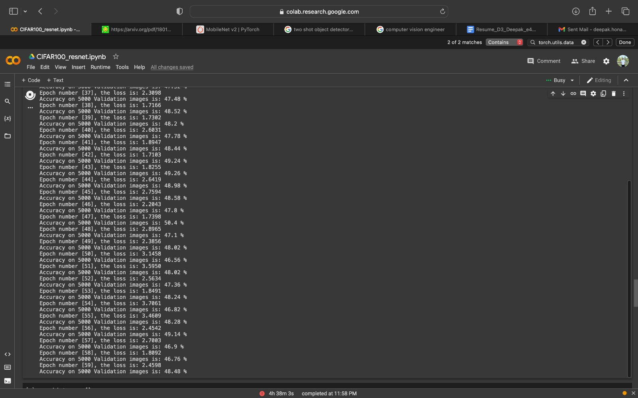
PROPOSED APPROACH
CNN Models
We have looked into 4 different families of models for this project -
1. ResNet 34
As we can see in the figure below ResNet 34 was taking too long to train

Slide 8
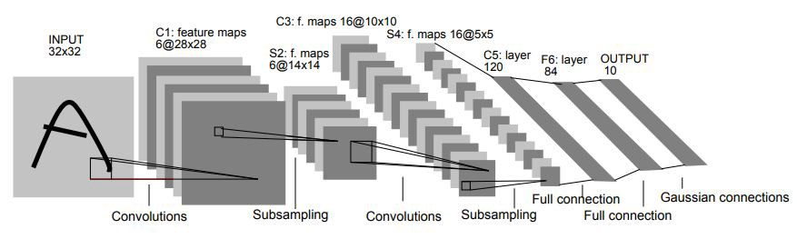
PROPOSED APPROACH
CNN Models
2. LeNet

Slide 9
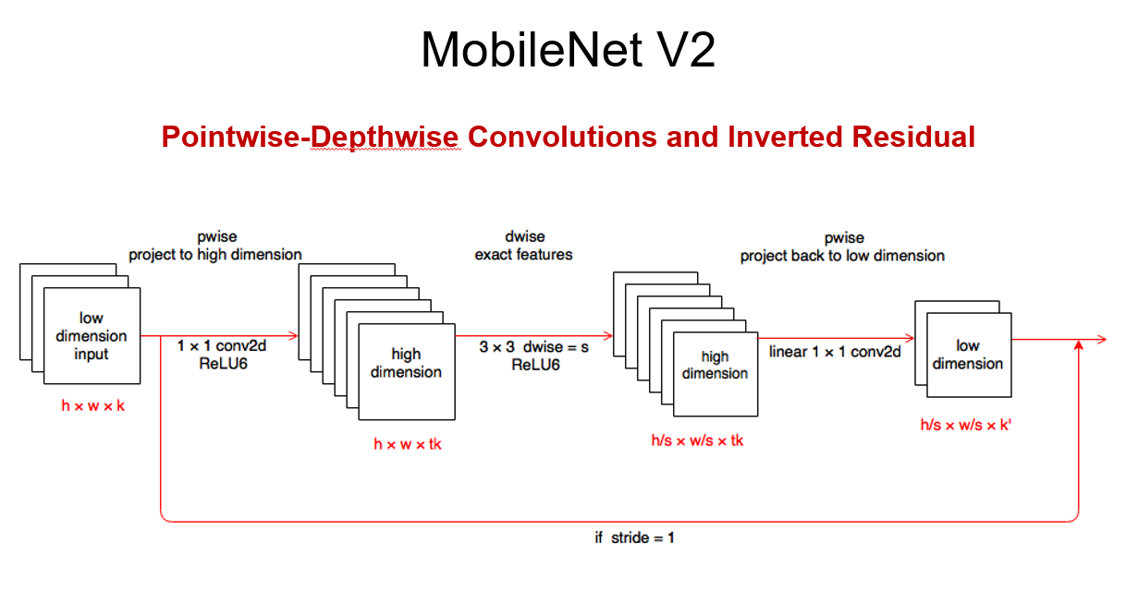
PROPOSED APPROACH
CNN Models
3. MobileNet V2

Slide 10
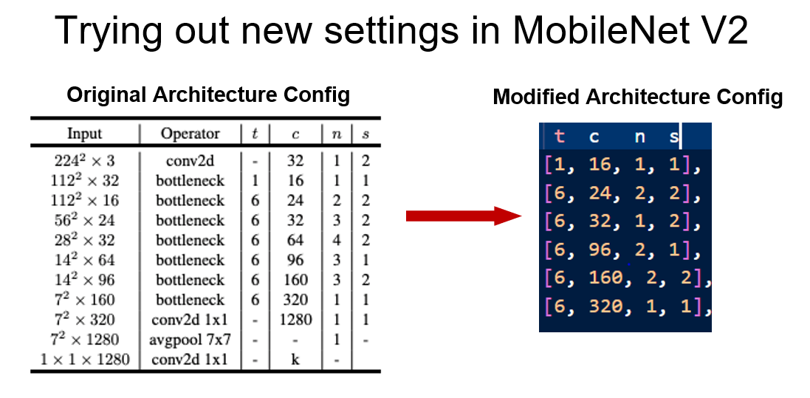
PROPOSED APPROACH
CNN Models
4. Proposed Approach

Slide 11
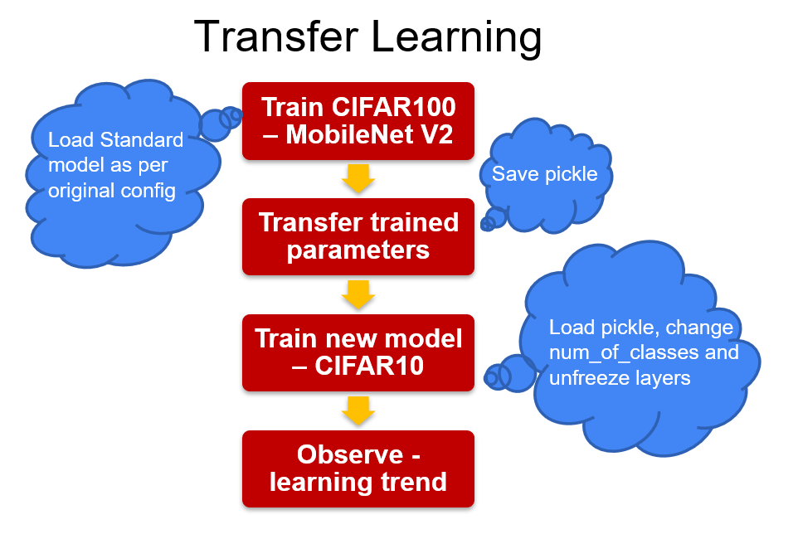
PROPOSED APPROACH
CNN Models
5. MobileNet Transfer Learning

Slide 12
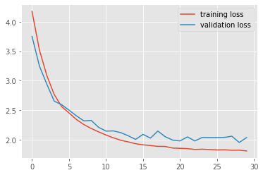
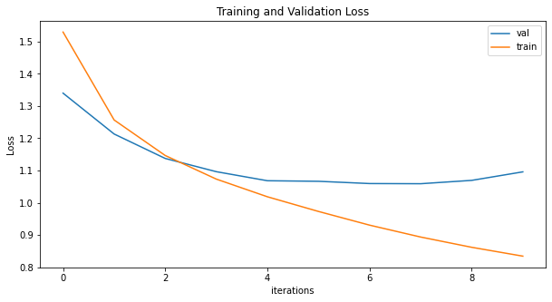
EMPIRICAL ANALYSIS
ResNet Loss Curve
Lr = 0.1, SGD optimizer
LeNet Loss curve
Lr = 0.001, Adam optimizer

Slide 13
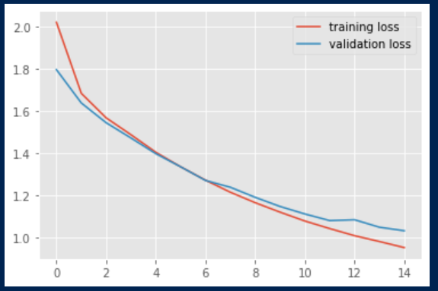
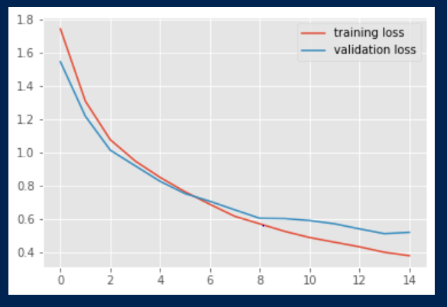
EMPIRICAL ANALYSIS
AdaDelta Loss Curve lr = 0.01
MobileNet
Adam Loss Curve lr = 0.01
MobileNet

Slide 14
RESULTS
Results and Analysis -
Out of all models, the ResNet model had the highest accuracy for all the datasets while LeNet was the least efficient model
Run time and inference time were best for MobileNet.
After performing hyperparameter tuning we got the best results with Adam optimizer and with 0.01 Learning Rate.
Most models performed good with LR = 0.01
All models took the lowest number of epochs to train the CIFAR 10 dataset and also had the highest accuracy for the CIFAR 10 Dataset in comparison to the two datasets

Slide 15
CONCLUSION
Tried to propose image classification model specific to a certain kind of application.
Observed trends on hyperparameter tuning
Understanding the impact of transfer learning (even though on small scale)
Tried level best to work on above points with limited computational capabilities
Got slight insight into CNN family model and motivation to work on new ideas.

Slide 16
Thank you!

